Slide 1

IT5002
Computer Systems and Applications
Welcome to IT5002
colintan@nus.edu.sg

Slide 2
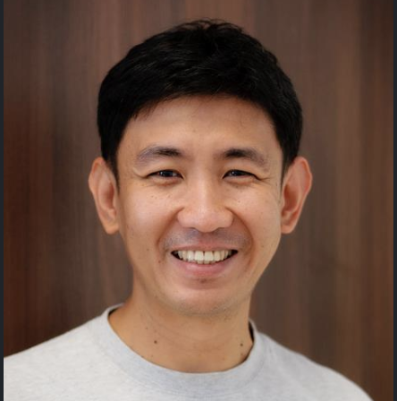
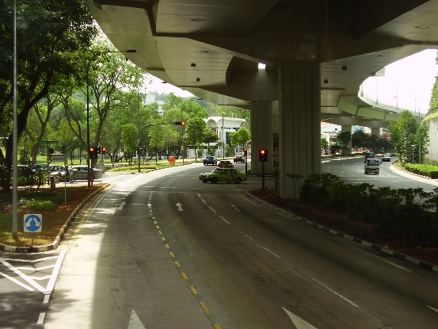

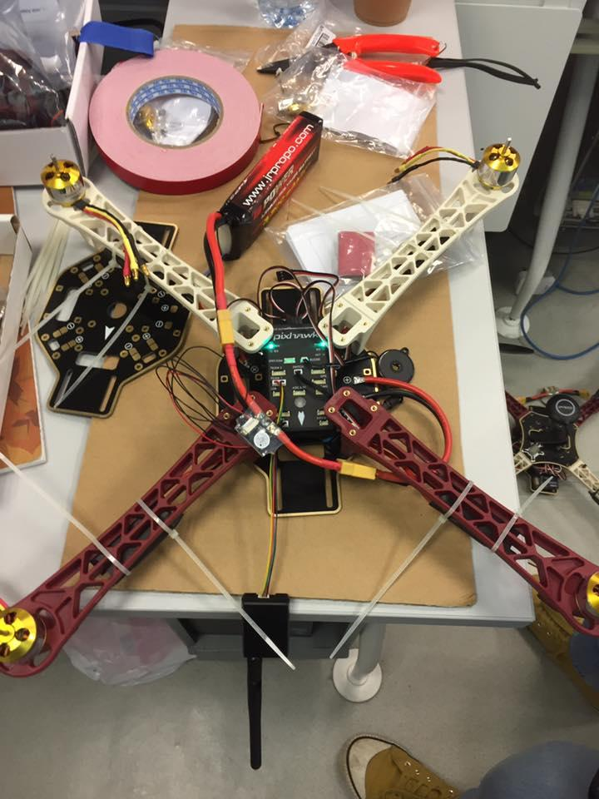
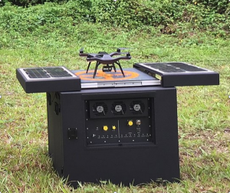
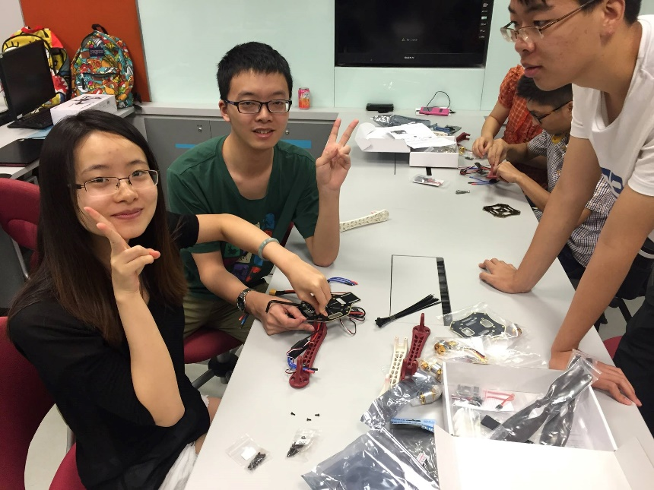
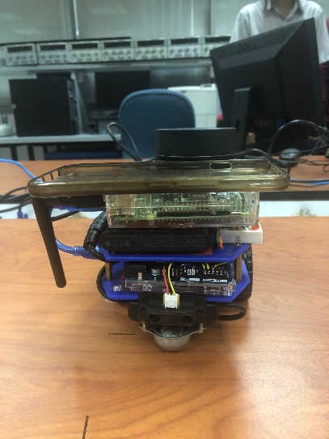
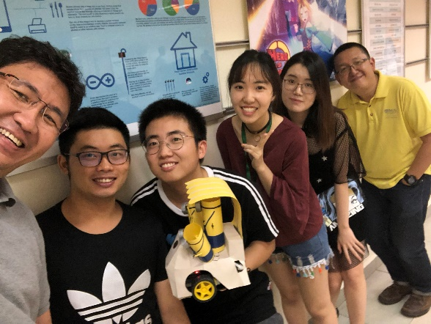
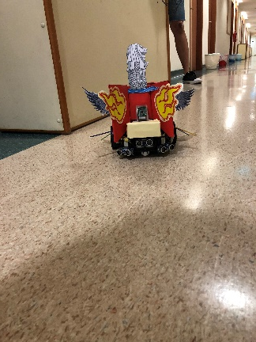
Colin Tan
Consultation:
Zoom only.
Email: colintan@nus.edu.sg
Admin appointment:
Chief Randomness Generator,
Makers@SoC

Slide 3
IT5002 Computer Systems and Applications Course Objective
The objective of this module is to familiarise students with the fundamentals of computing devices and applications
This is a fast paced, intense course.
But you will learn a lot.
Topics
Part 1: Processor Organization
Interfacing High Level Programming Languages to Hardware.
Data representation and number systems
Assembly language
Processor datapath and control
Pipelining (Brief)
Cache (Brief)
Part 2: Operating Systems
Part 3: Applications - The Web, Databases and Blockchains

Slide 4
IT5002 Computer Systems and Applications Course Objective
The objective of this module is to familiarise students with the fundamentals of computing devices and applications
This is a fast paced, intense course.
But you will learn a lot.
Topics
Part 1: Processor Organization
Part 2: Operating Systems
OS Architecture.
Process Management
Process Coordination
Memory Management
File Management
Part 3: Applications - The Web, Databases and Blockchains

Slide 5
IT5002 Computer Systems and Applications Course Objective
The objective of this module is to familiarise students with the fundamentals of computing devices and applications
This is a fast paced, intense course.
But you will learn a lot.
Topics
Part 1: Processor Organization
Part 2: Operating Systems
Part 3: Applications - The Web, Databases and Blockchains
Basics of the Web – HTTP, HTML, MIME Types, RESTful Servers
Relational Databases
Document Oriented Databases
Blockchains: Principles, Cryptographic Hashes, Chain Structure, Proof of work, Chain Resolution, 51% Attacks, Proof of Authority, Proof of Stake.

Slide 6
Lectures
Lectures are F2F and over Zoom. You should attend the F2F lectures.
https://nus-sg.zoom.us/j/99638418357?pwd=SXNiSm4zVm5NSThmaDRITnVGZTU1QT09
Meeting ID: 996 3841 8357
Passcode: 941586

Slide 7
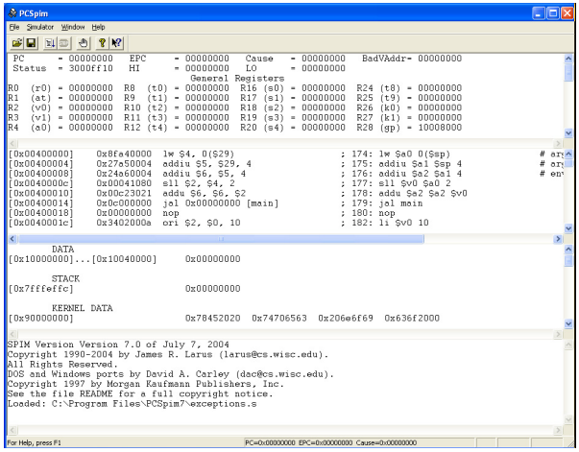
Practical Aspects
Tutorials / Labs most Saturdays, 2-3 pm or 3-4 pm from Week 3 onwards
QTSpim (MIPS Assembly)
Creation and coordinating processes and threads (Python)
MySQL and MongoDB Programming (Python)

Slide 8
Assessment
CA component | Weightage
Tutorials / Labs | 5%
Assignment | 15%
Mid-Term Test* | 25%
Final Exam* | 55%
* Face-to-Face Electronic Assessments (Examsoft). Four-page cheat-sheet (2 A4 sheets)

Slide 9
Admin Matters
Lectures are 3 hours long, every Tuesday 6.30 pm to 9.30 pm
All course materials will be uploaded on Canvas.
Tutorials/Labs start in week 3 (29th August 2023)
Mid-term test
Saturday 21 October 2023, 2.00 pm – 3.30 pm (during tutorial slot)
Please check Canvas announcements for updates
Please post your queries on Canvas forums
Everybody can help answer and everybody can read the answers
Email me at colintan@nus.edu.sg only for personal matters

